Slide 1
Java Class
Day 5

Slide 2





Jul
Aug
TOEIC(7/24) 6/6~7/11
TEPS(7/16) 6/29~7/12
TOEIC(8/07) 6/20~7/25
TOEIC(8/21) 7/ 4 ~ 8/ 8
TEPS (8/06) 6/20~7/17
TEPS (8/20) 7/ 4 ~7/31
Big Data Analyst(10/1)
8/29~9/2
ADsP(8.28) 8/1~8/5
www.toeic.co.kr
www.teps.or.kr
www.dataq.or.kr
austin.sogang.ac.kr
austiny.snu.ac.kr

Slide 3
Mon
Tue
Wed
Thu
1. Main
Fri
1. Recap Sub
2. Main
2.
3. Main
3.
4. Main
4.
LUNCH
LUNCH
5. Sub
5. Recap Main
6. Sub
6.
7. Sub
7.
8. Recap, Test
8. Test
Jul
Aug
Java Basic
HTML, CSS, JS
Java Intermediate
Database

Slide 4
Java
8 Array
8.1 Array
8.1.1 Basic
8.1.2 Advance
8.2 Multi Dimensional Array
8.2.1 Basic
8.2.2 Advance
8.3 Exam

Slide 5
8 Array 8.1 Array

Slide 6
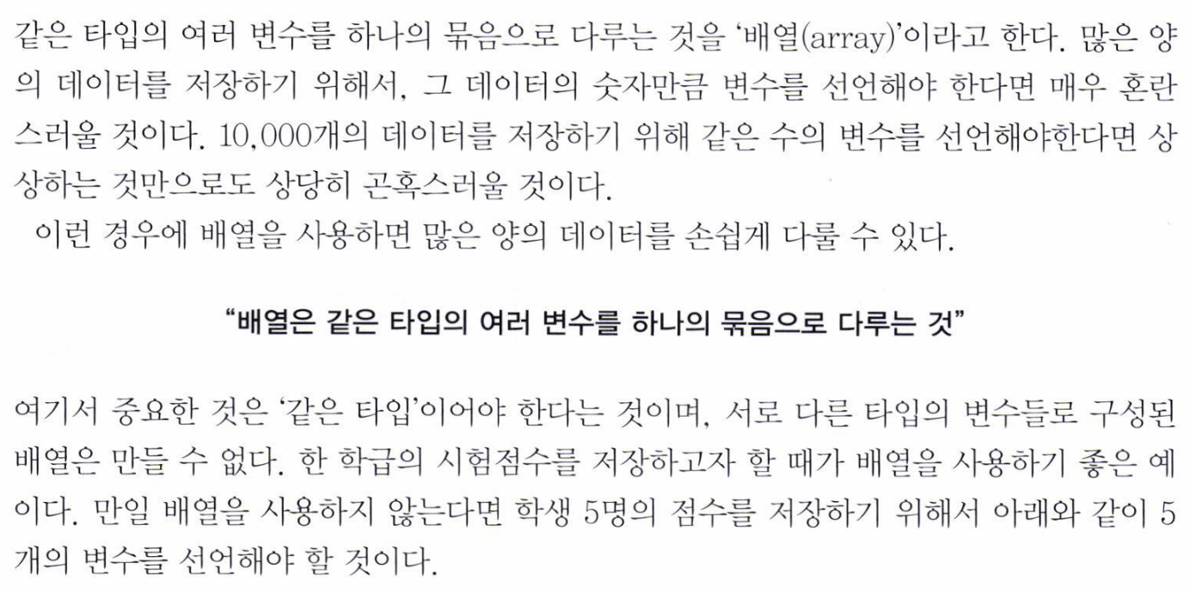

Slide 7
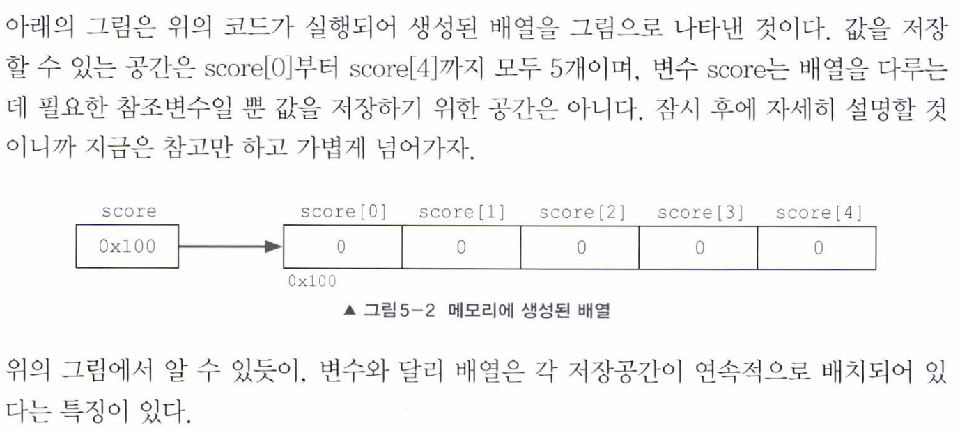

Slide 8
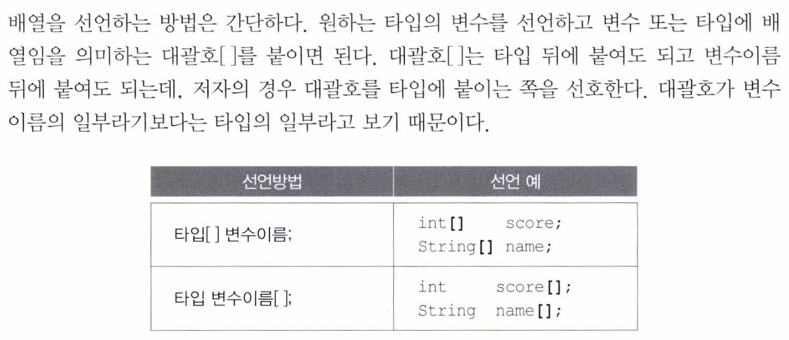

Slide 9
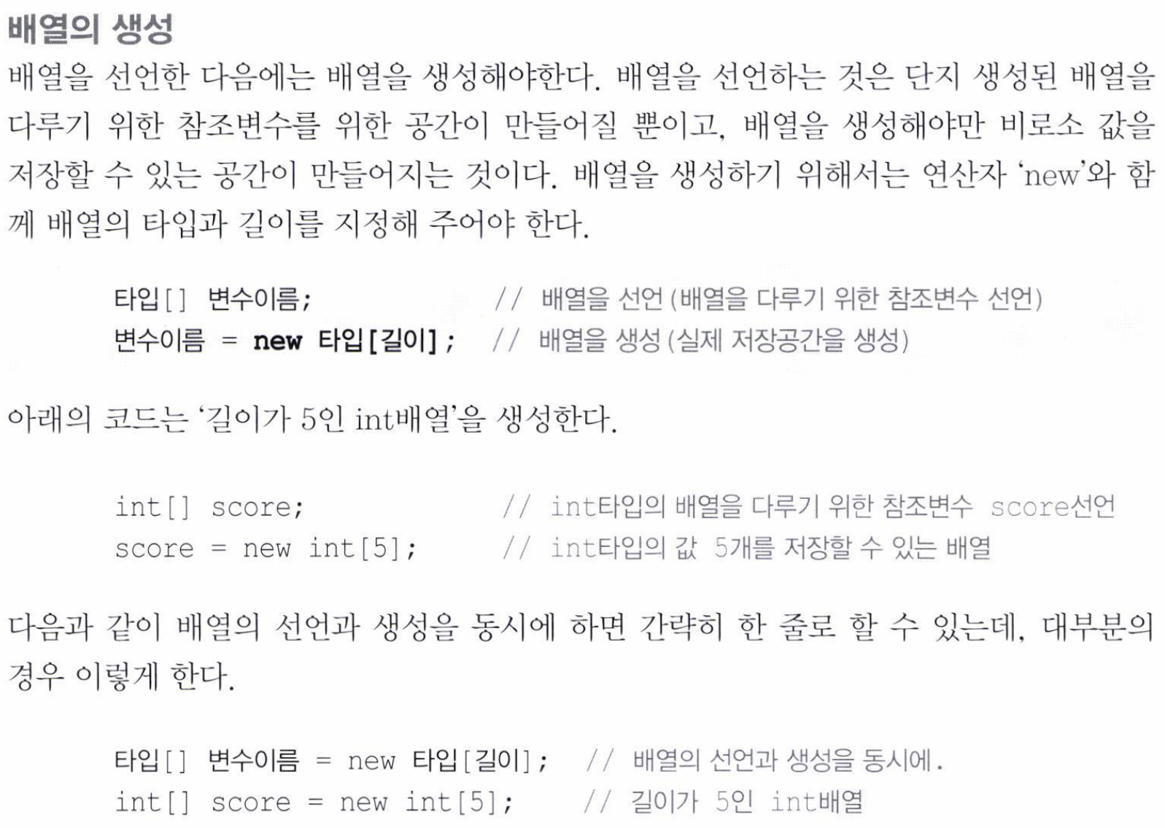

Slide 10
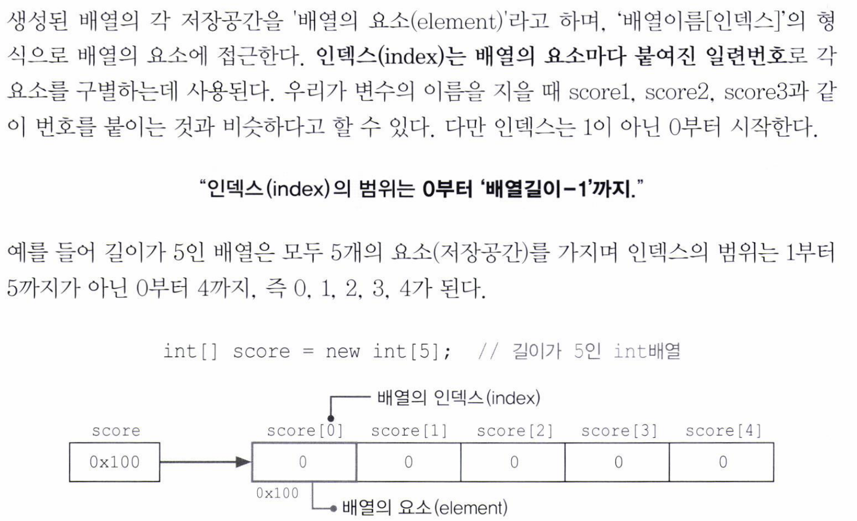

Slide 11
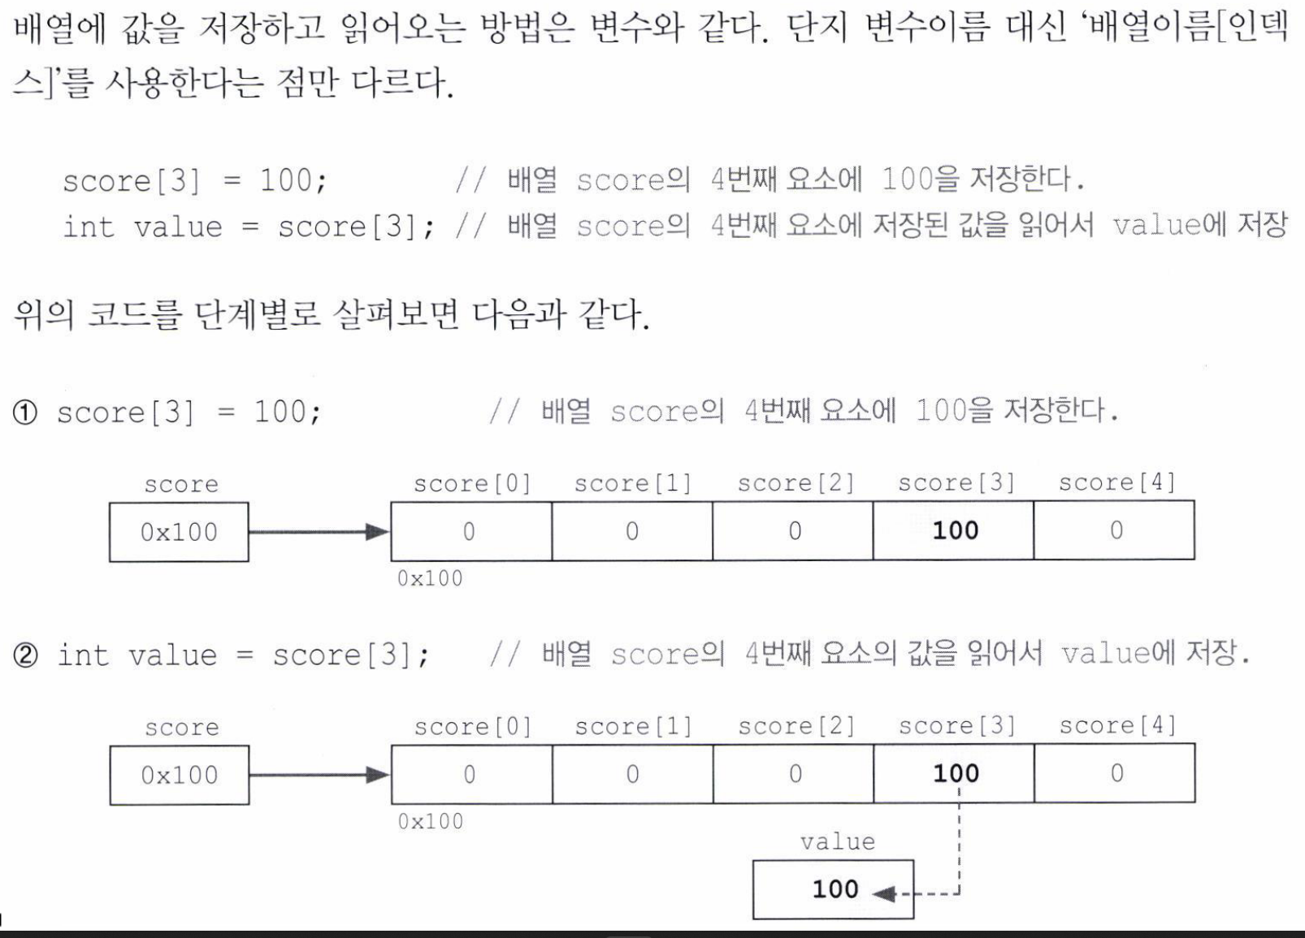

Slide 12
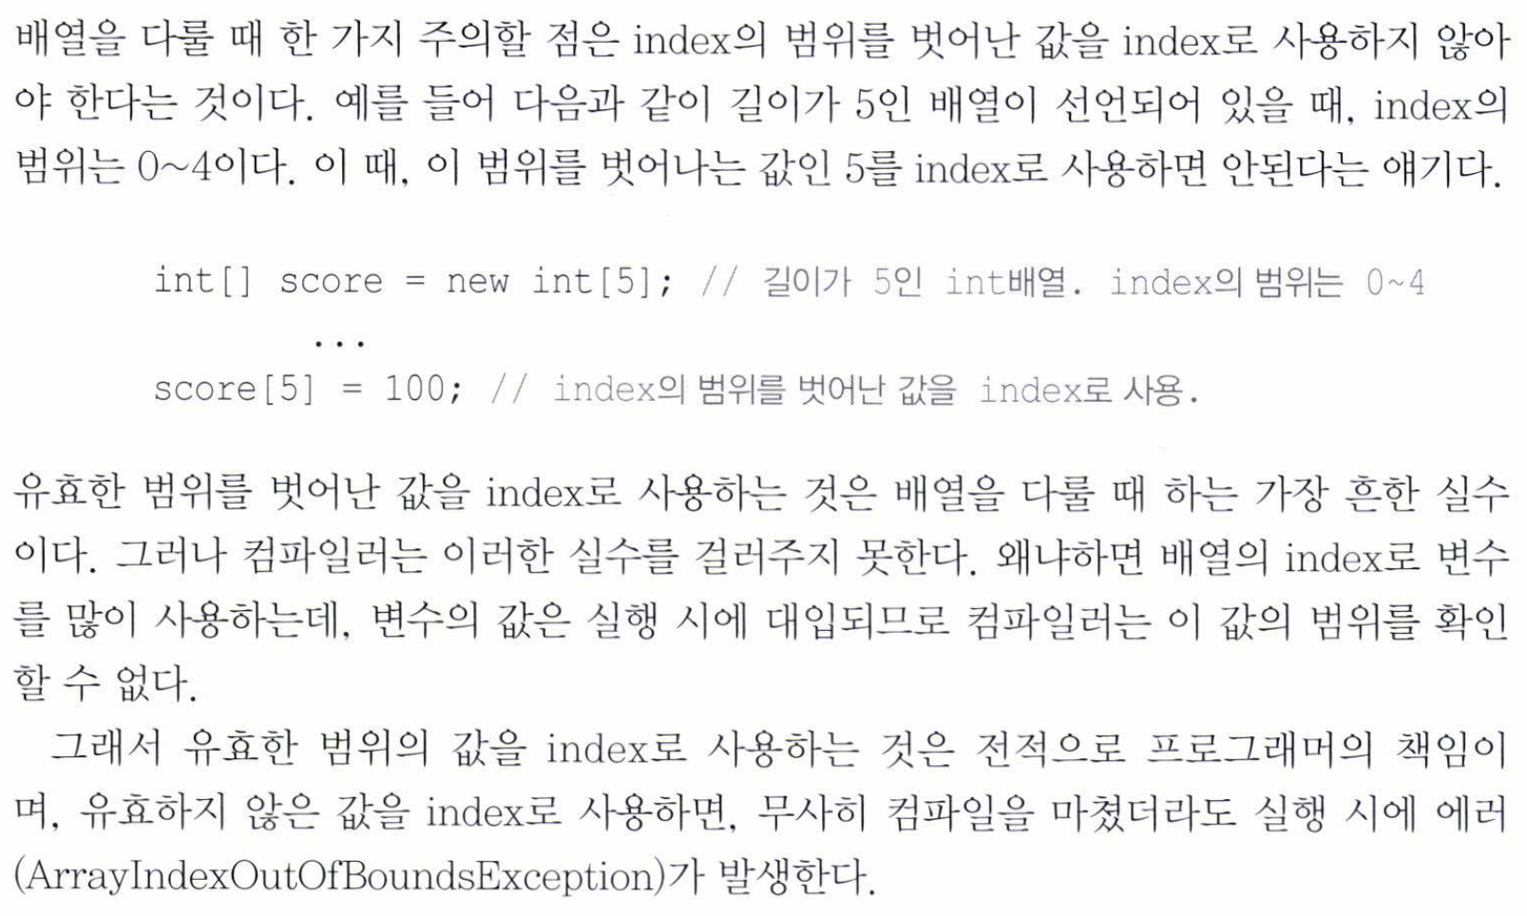

Slide 13
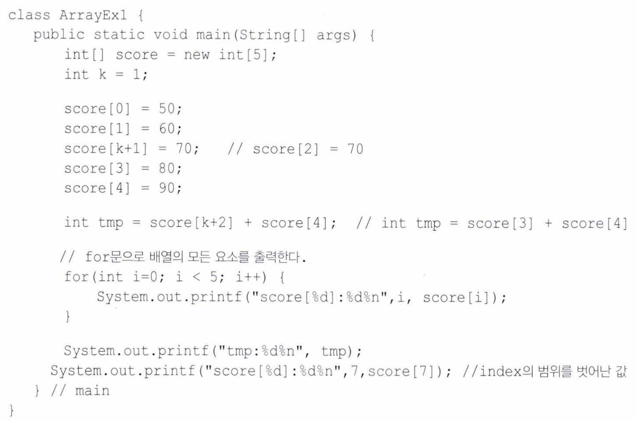

Slide 14
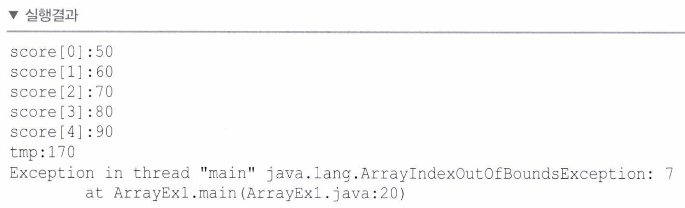

Slide 15
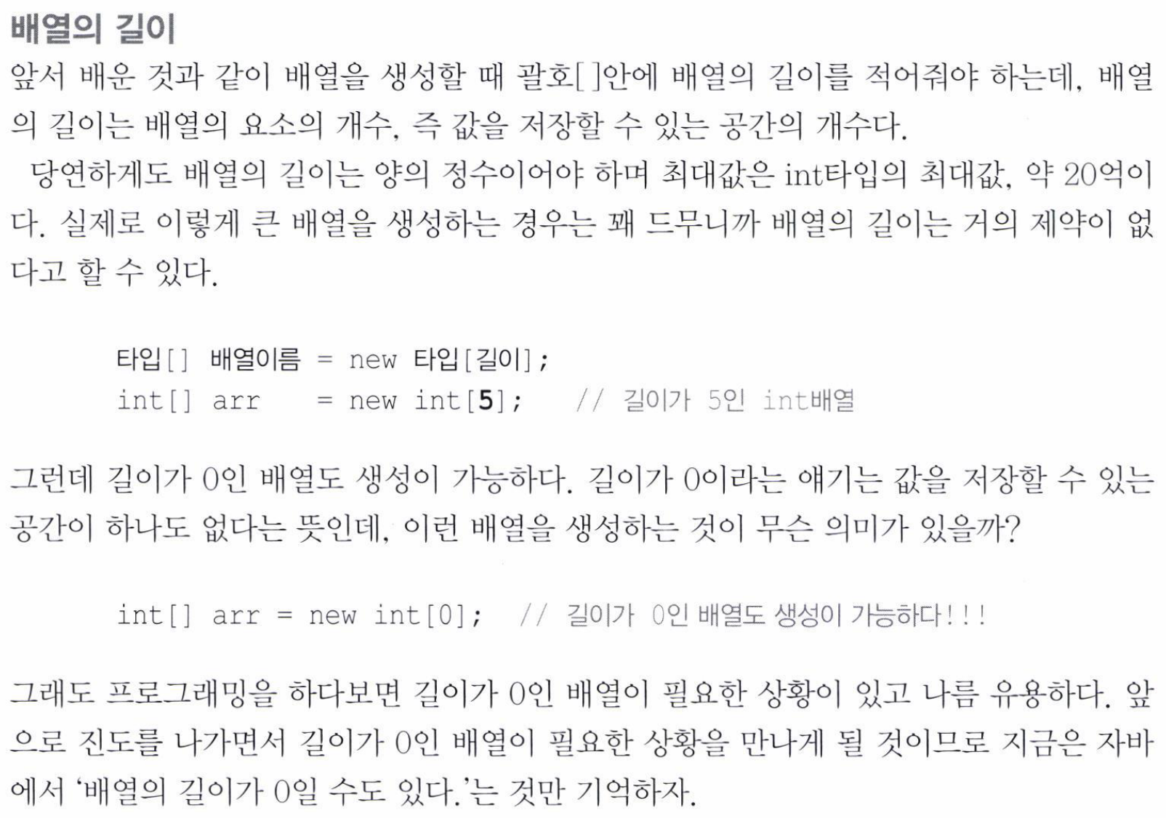

Slide 16
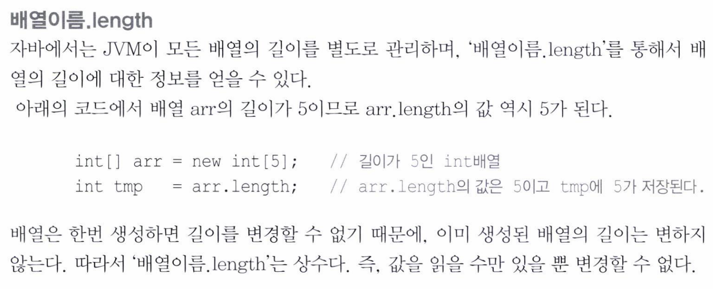

Slide 17
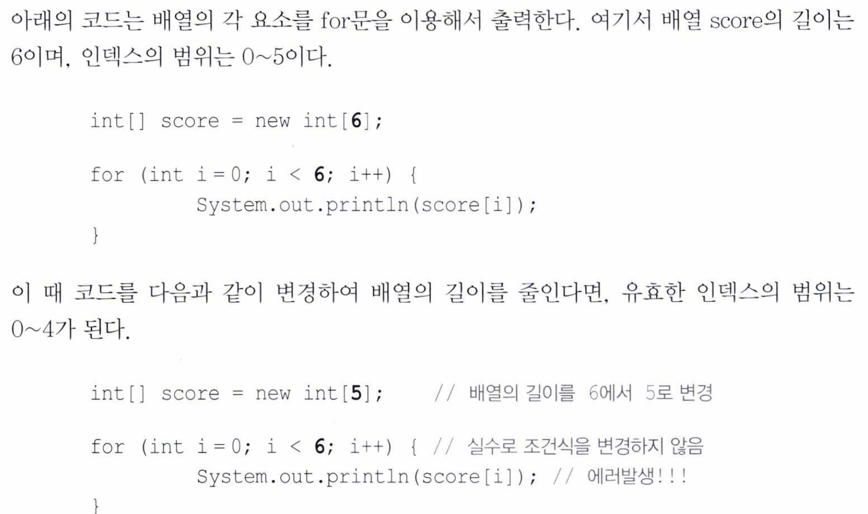

Slide 18
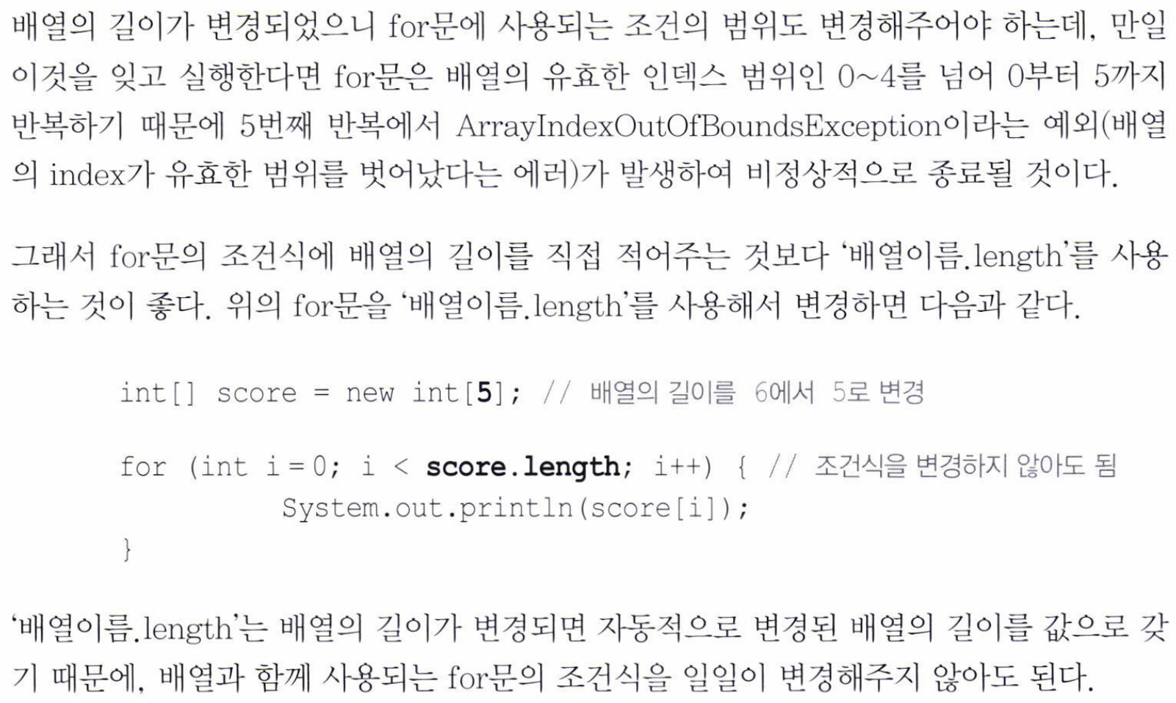

Slide 19
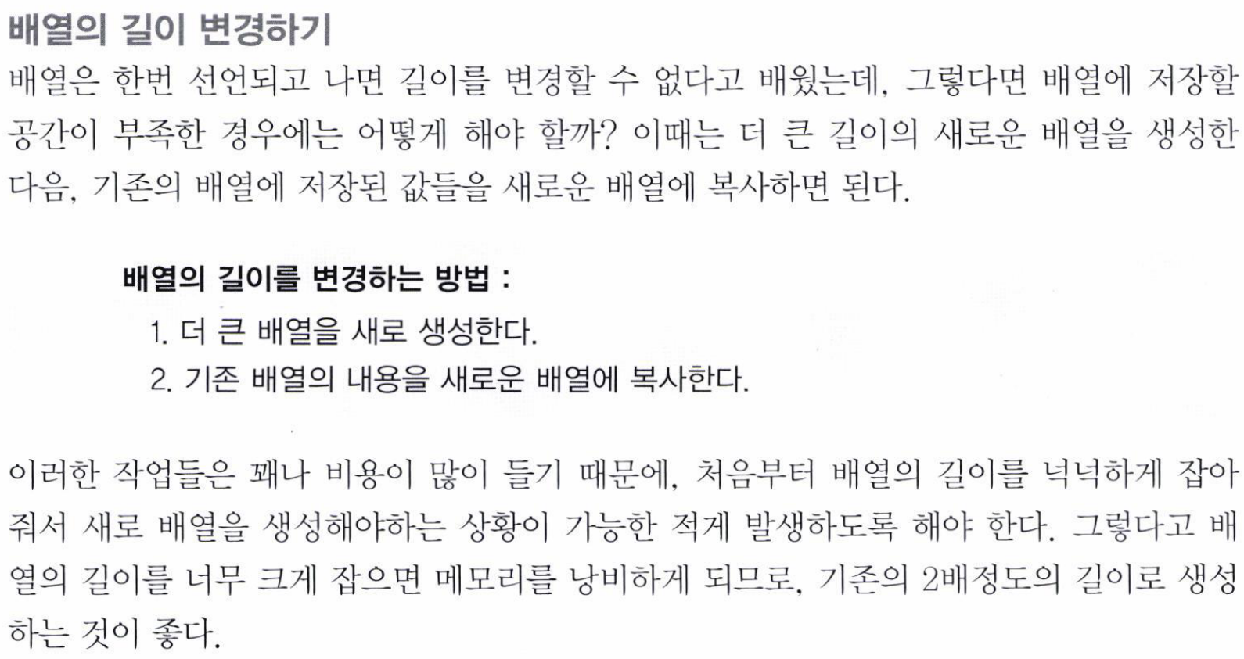

Slide 20
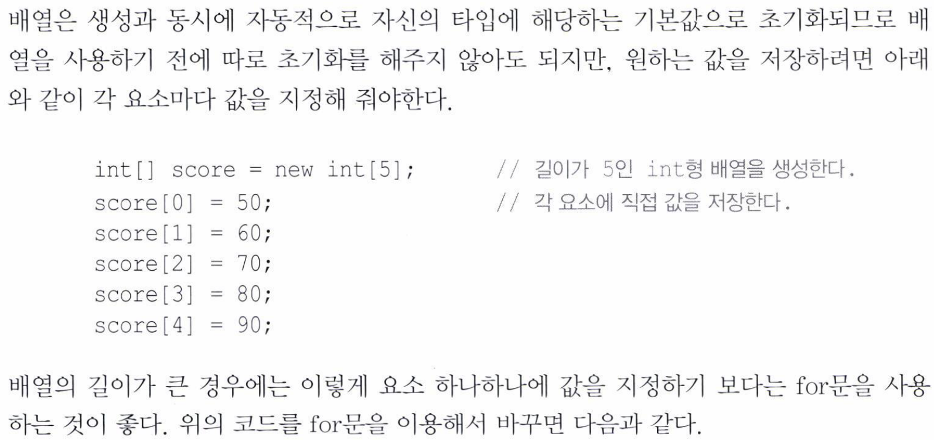

Slide 21
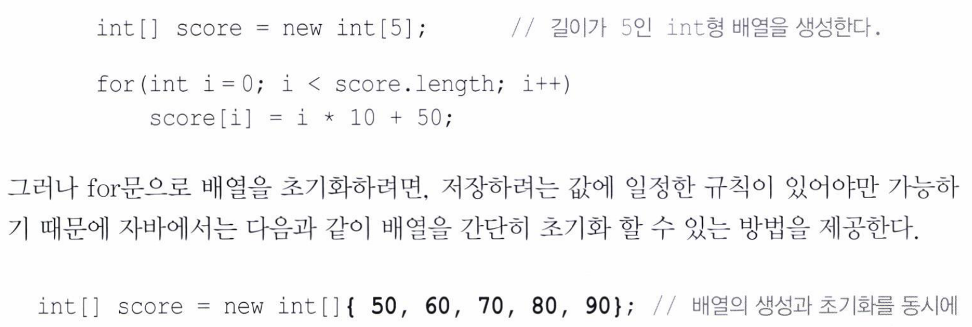

Slide 22
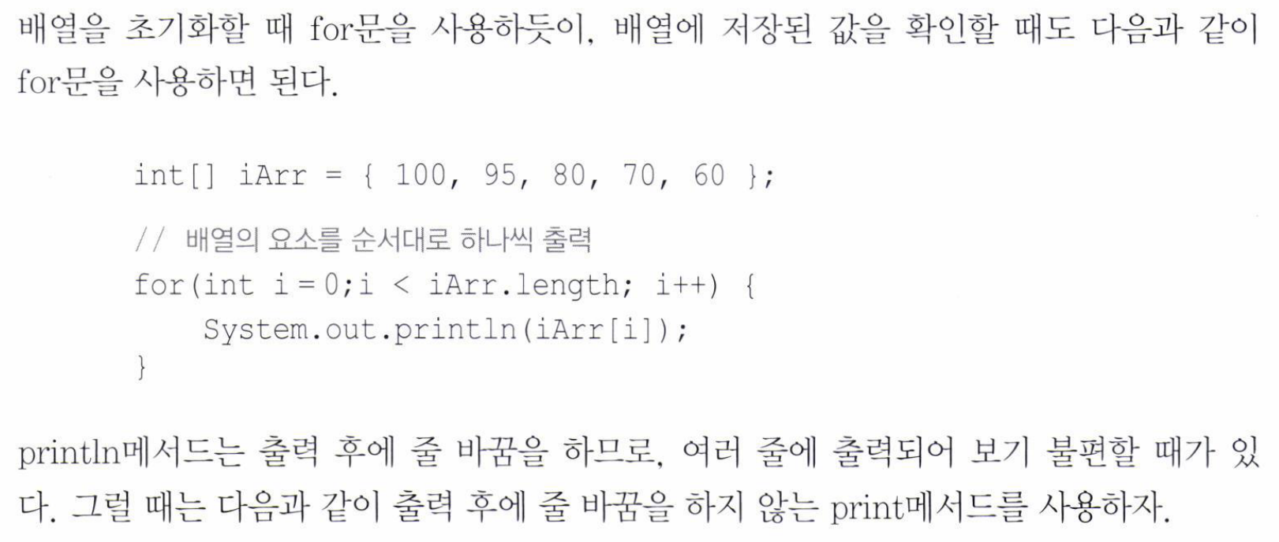
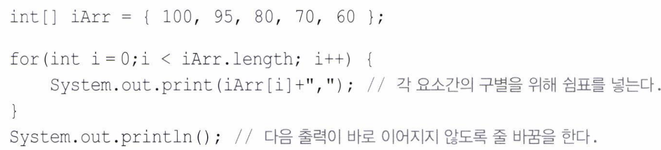

Slide 23
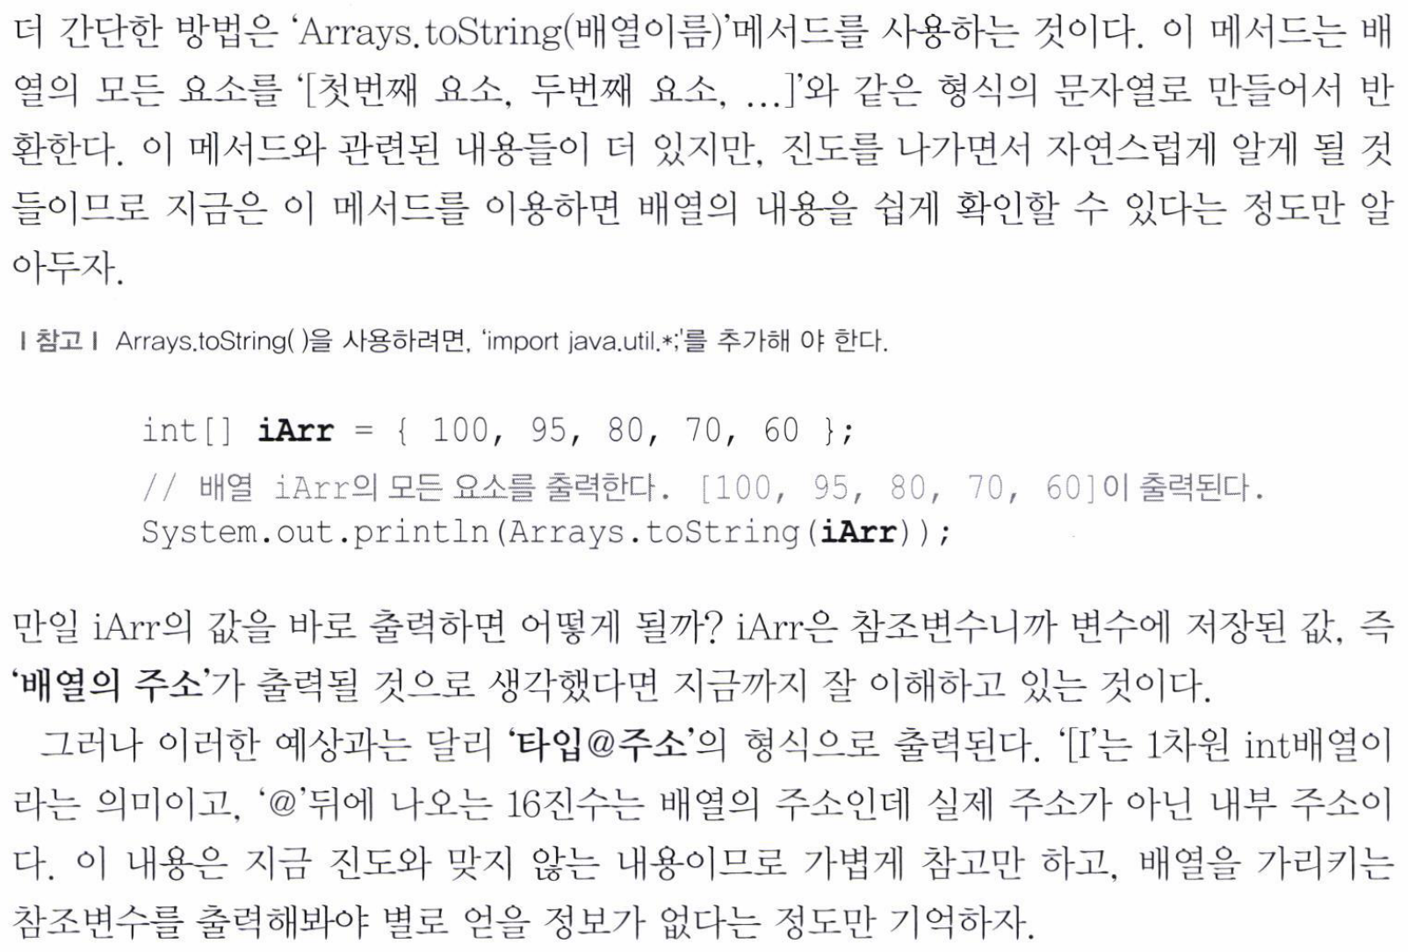

Slide 24
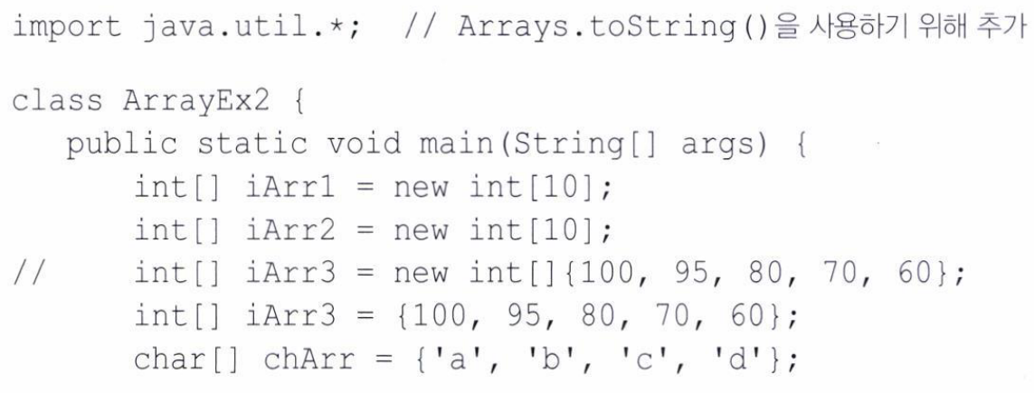
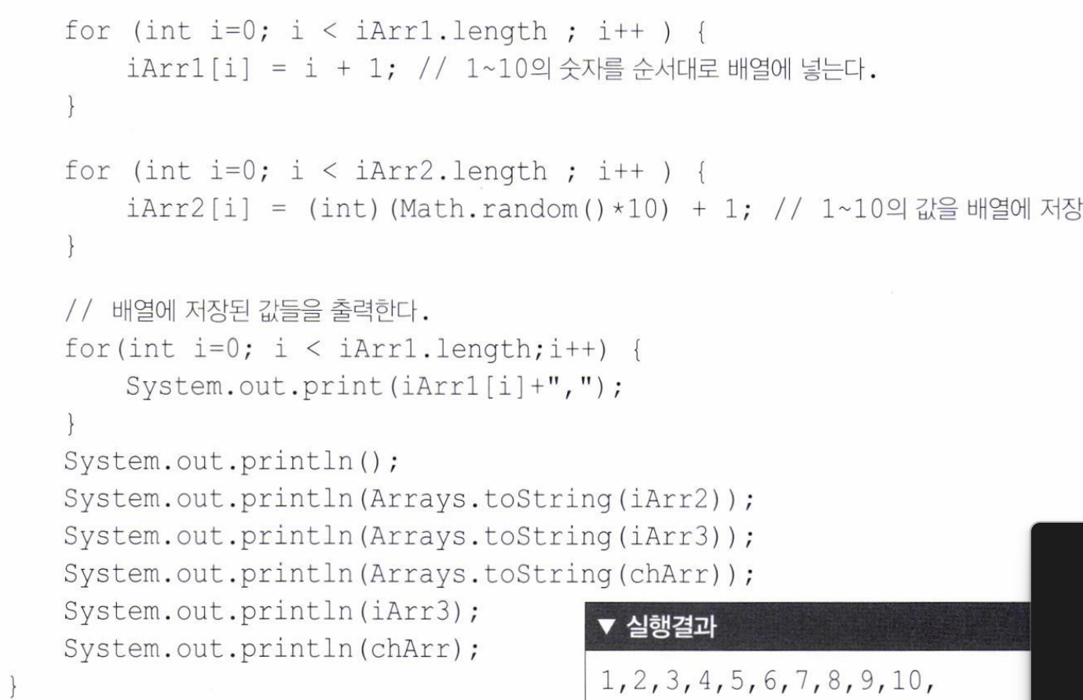
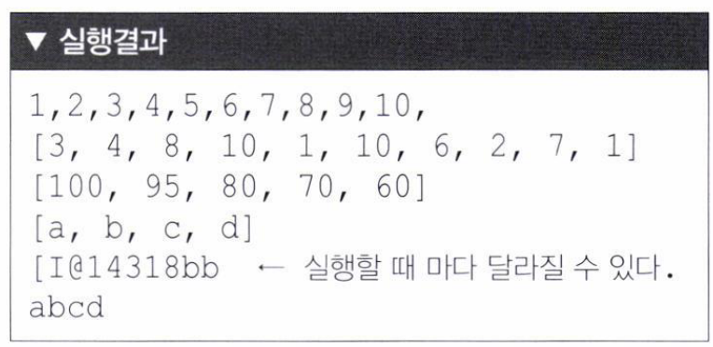

Slide 25
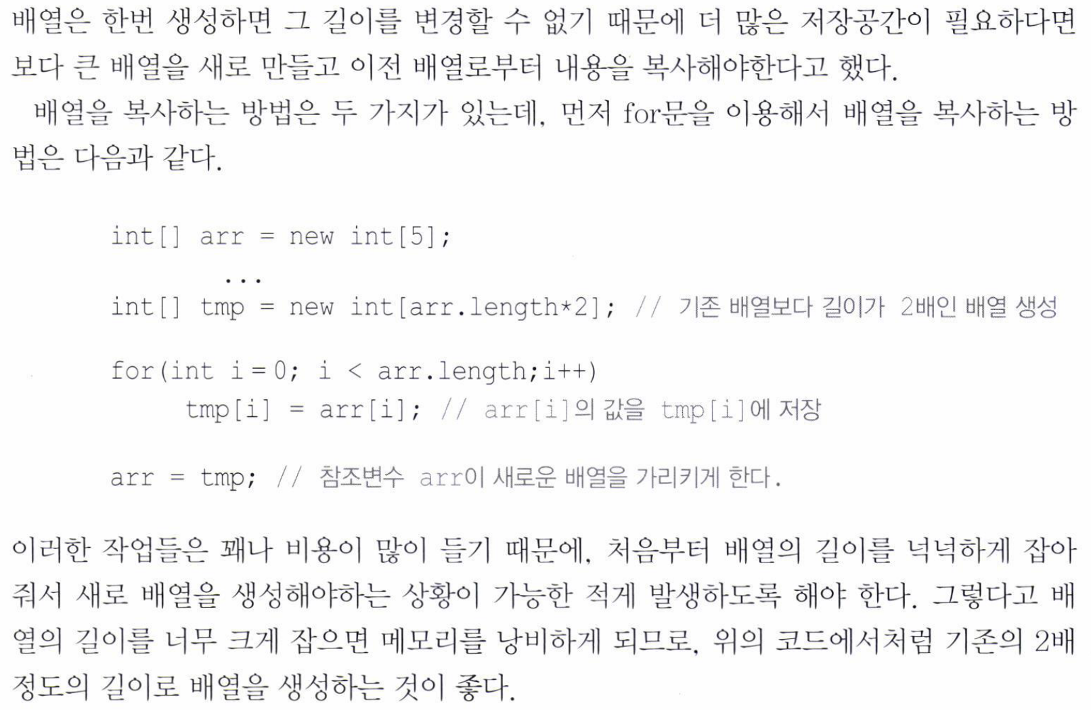

Slide 26
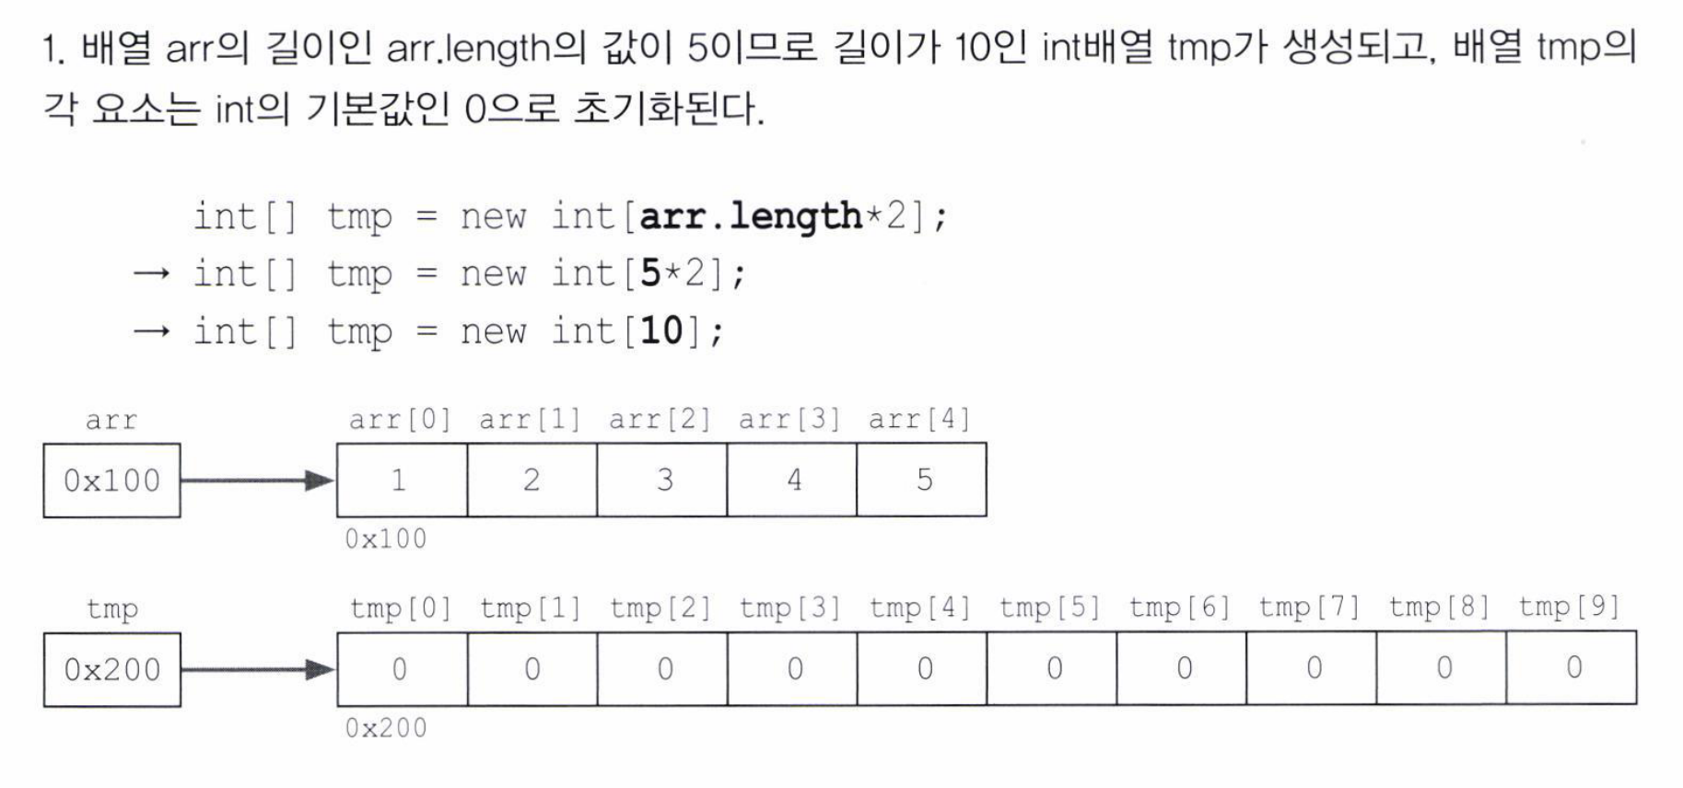

Slide 27
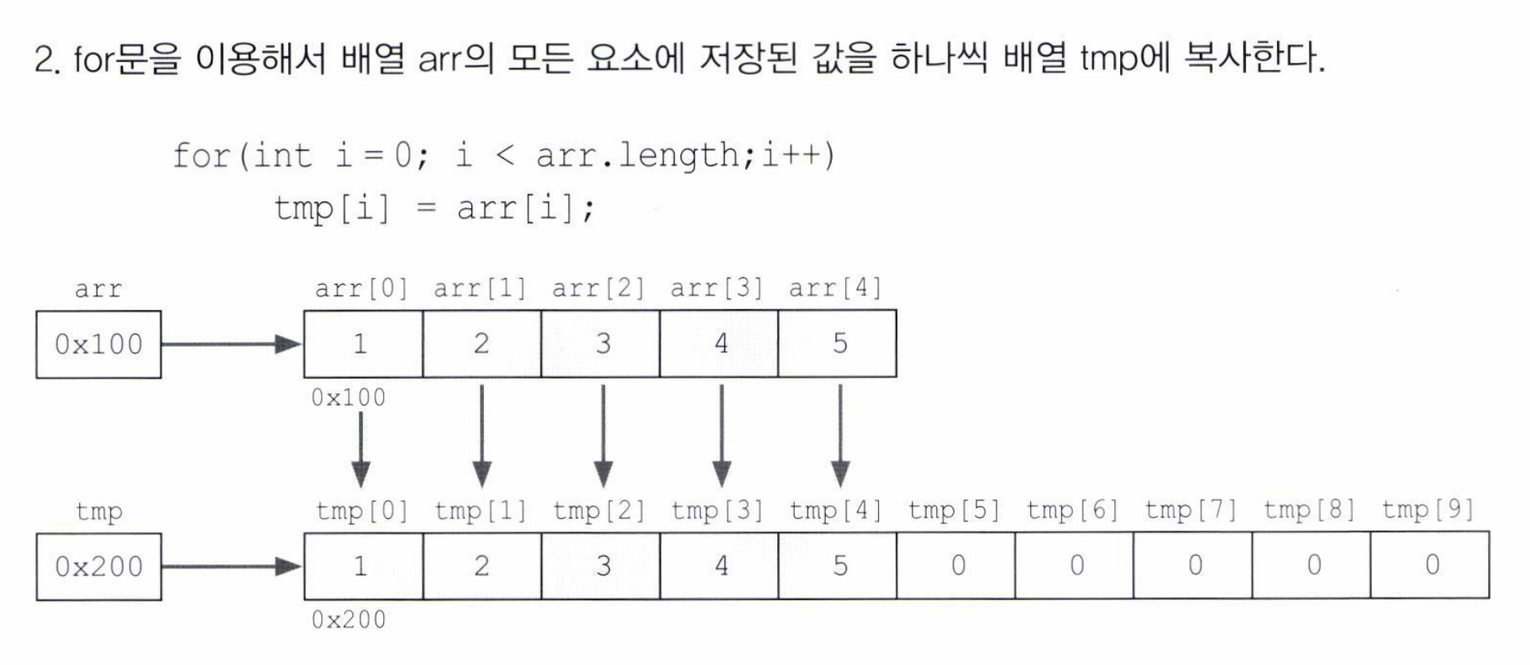

Slide 28
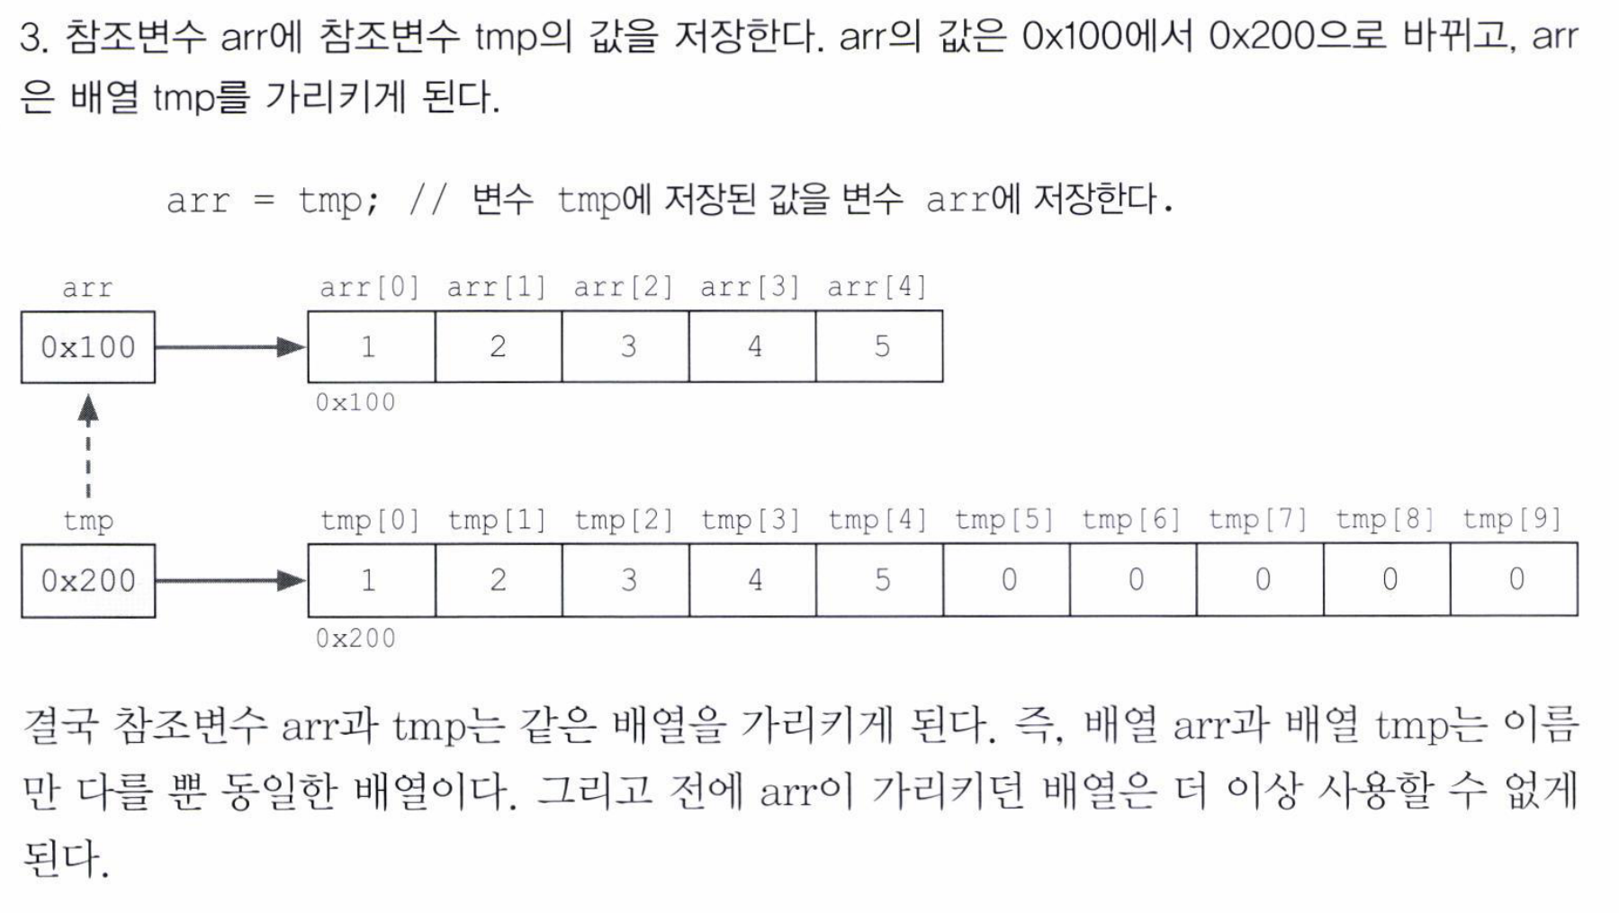

Slide 29
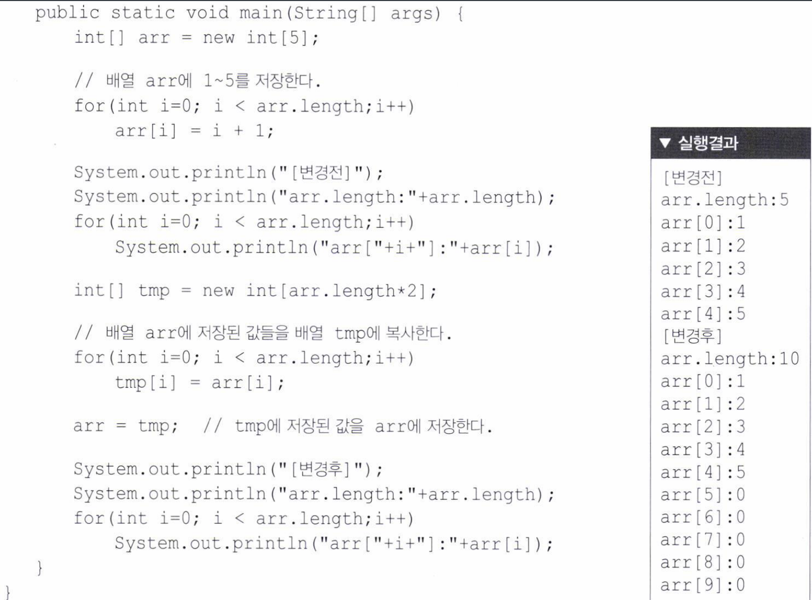

Slide 30
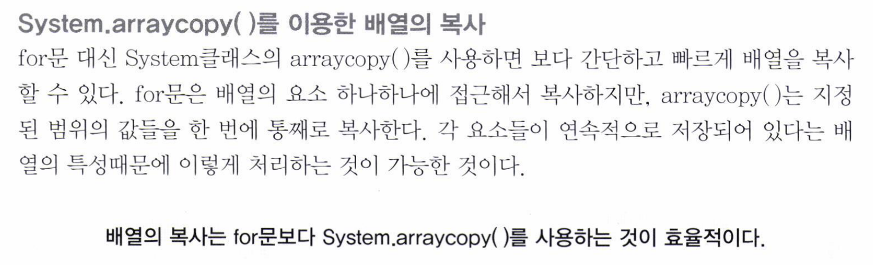

Slide 31
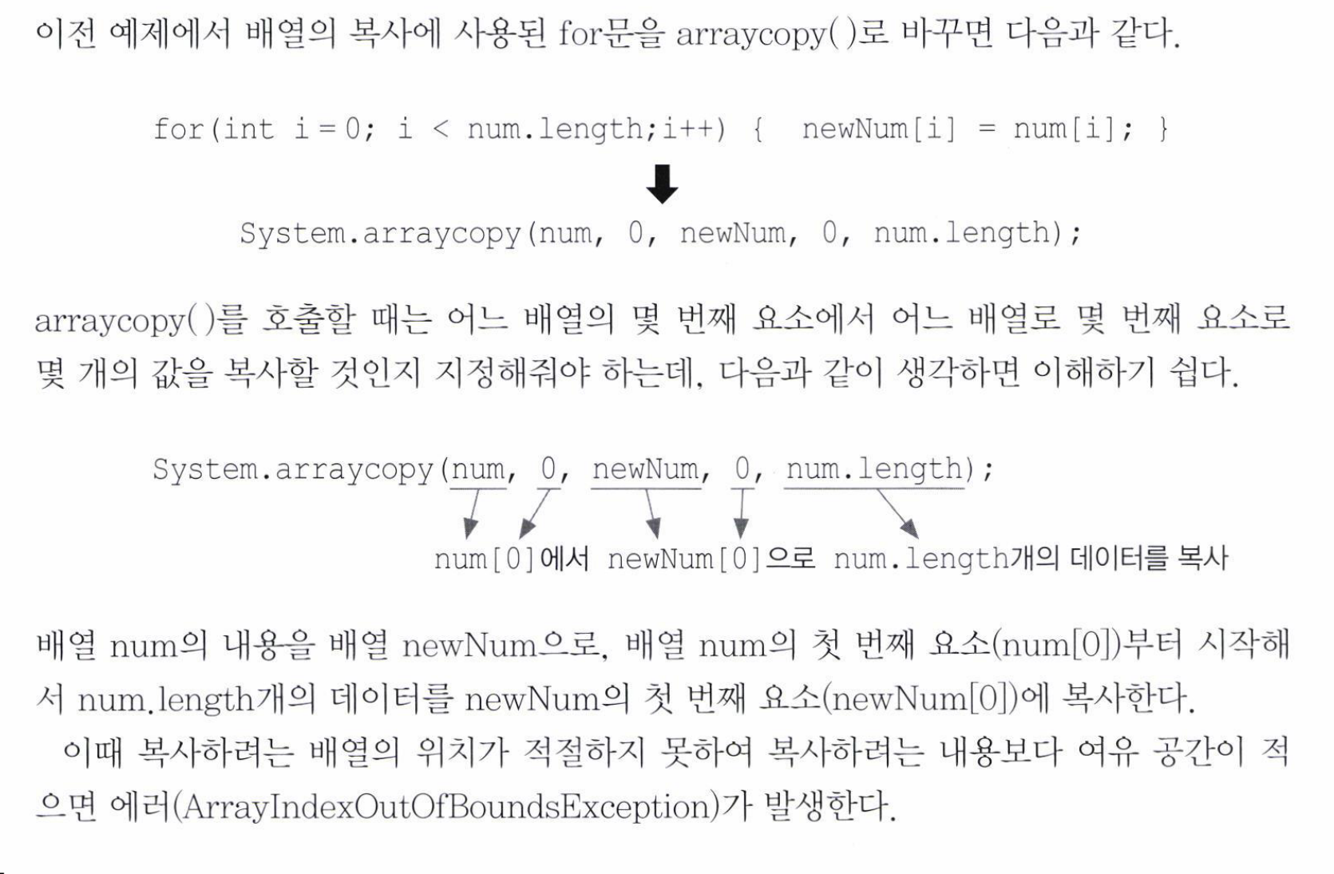

Slide 32
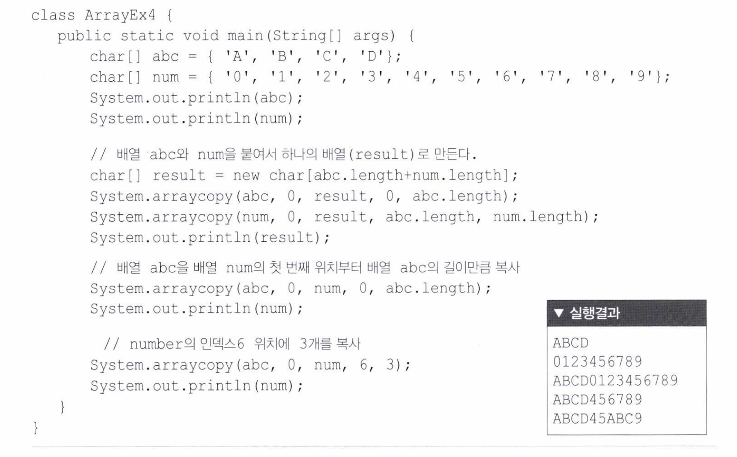

Slide 33
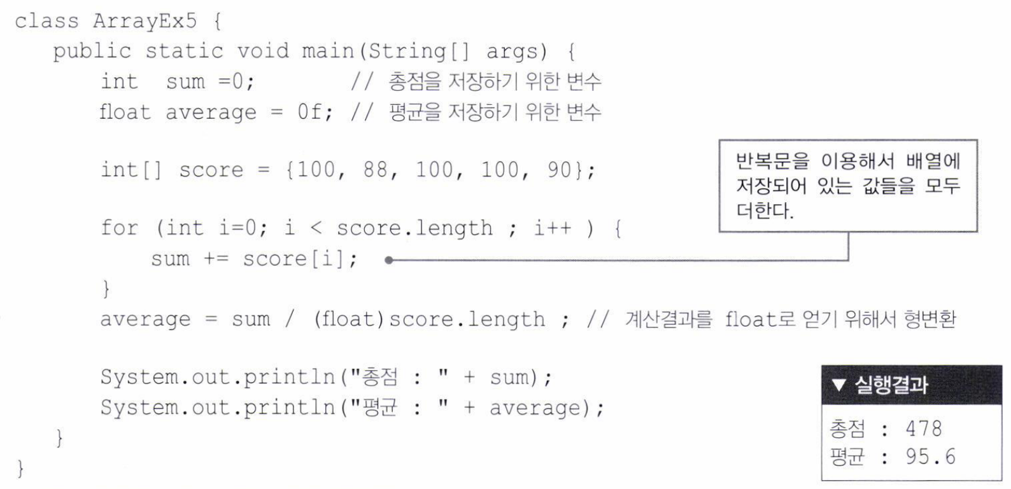

Slide 34
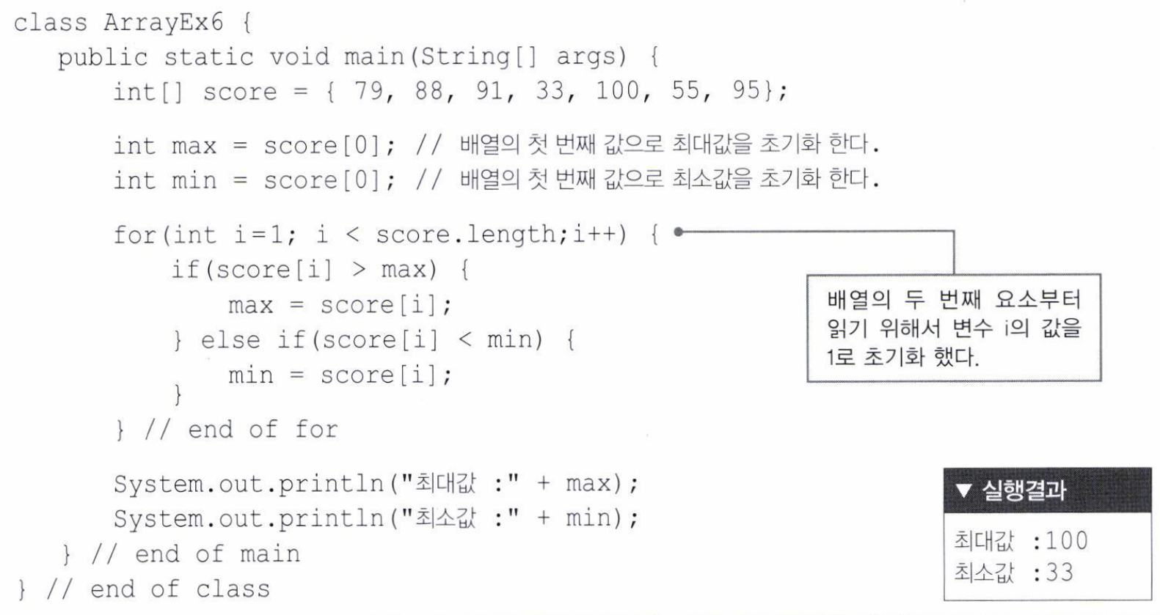

Slide 35
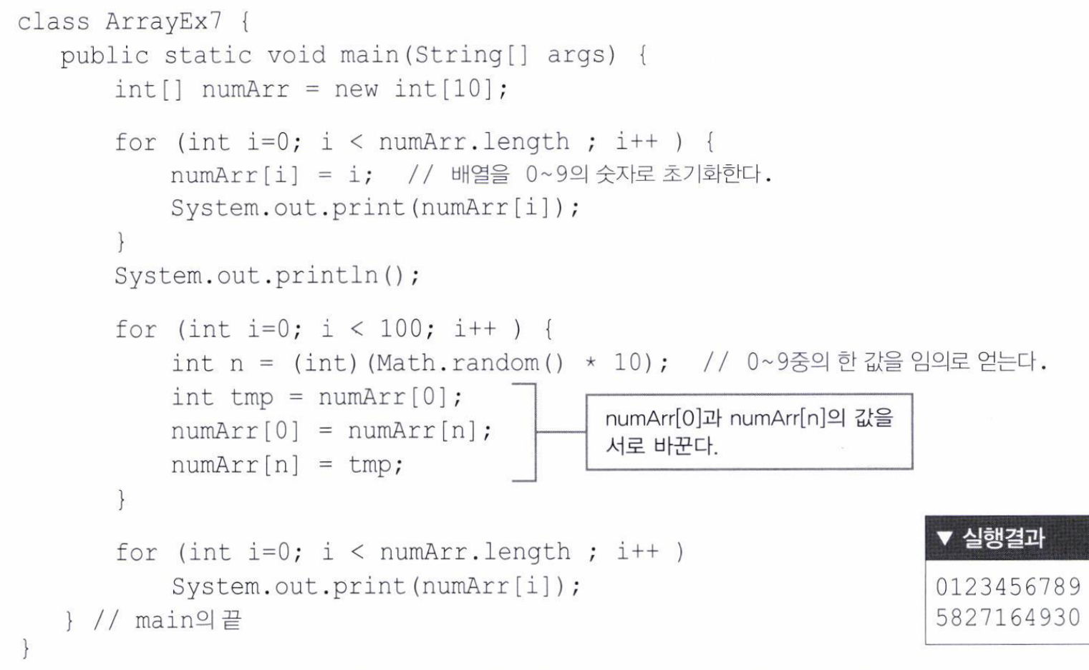

Slide 36
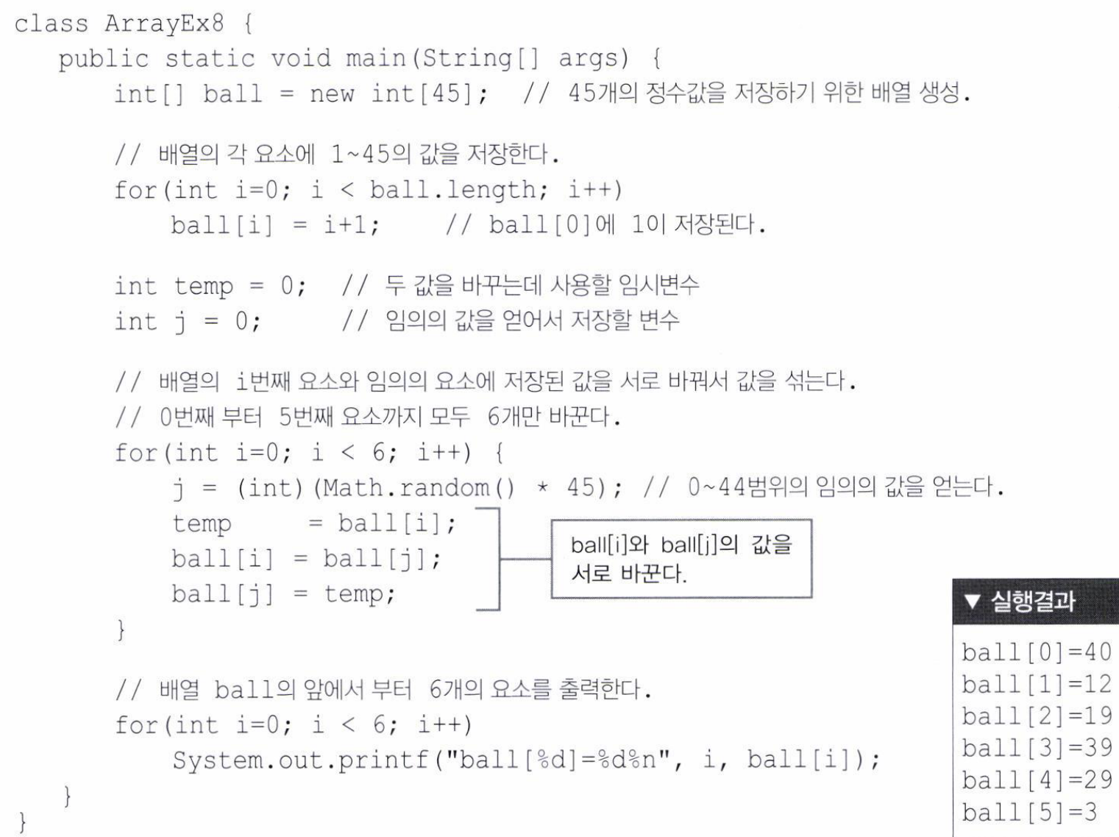

Slide 37
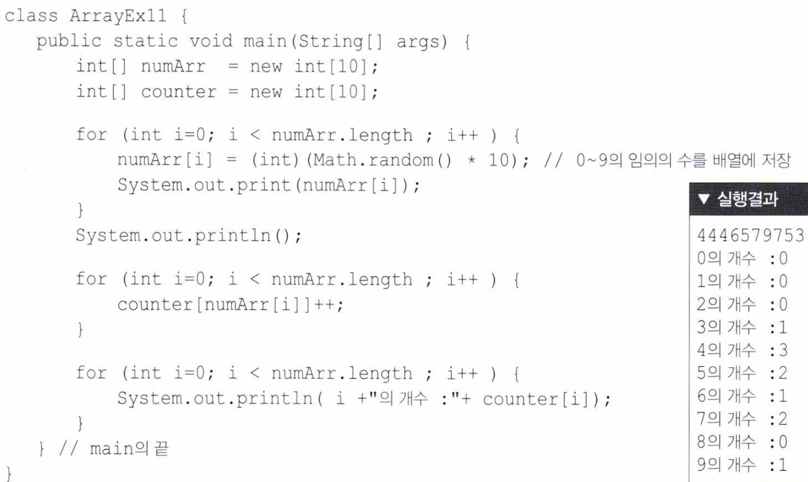

Slide 38
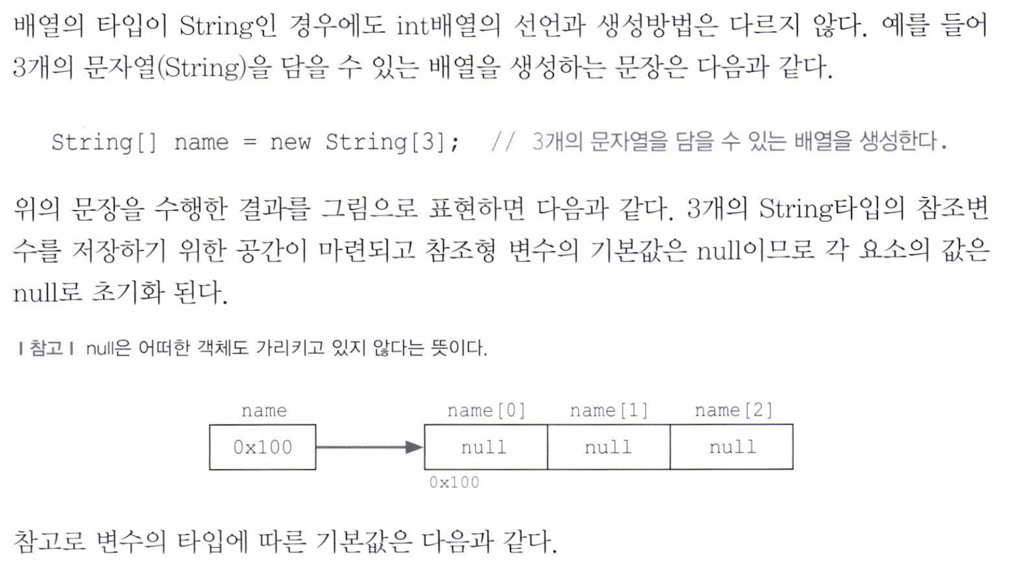
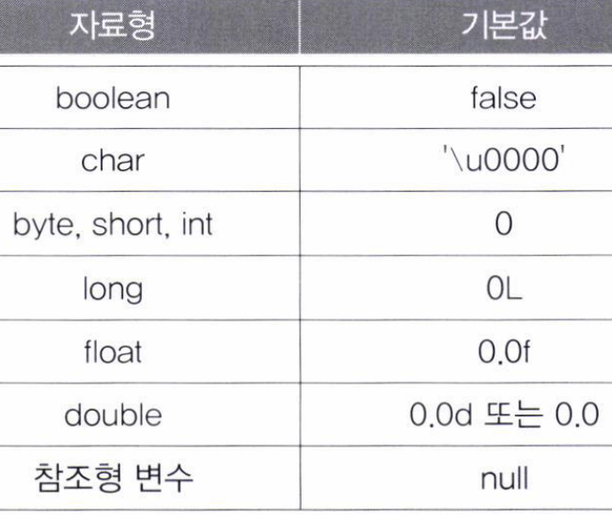

Slide 39
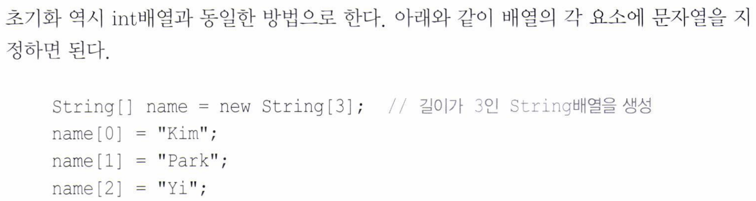
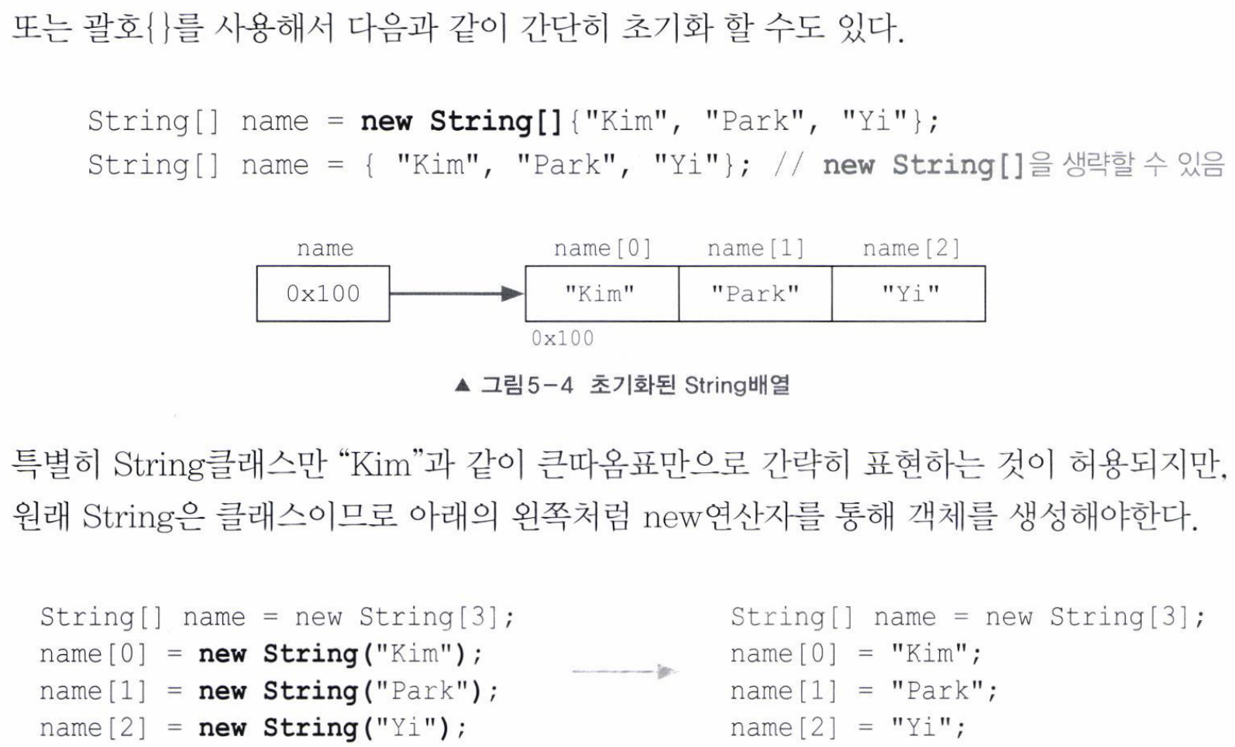

Slide 40
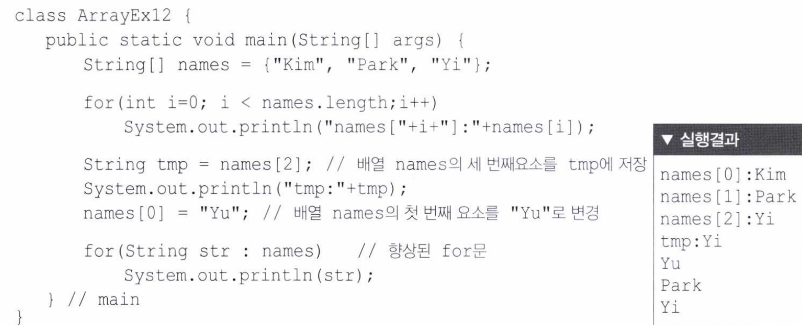

Slide 41
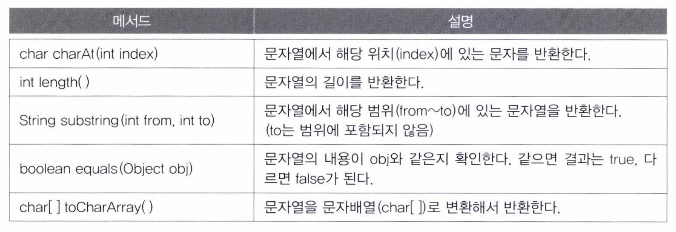

Slide 42
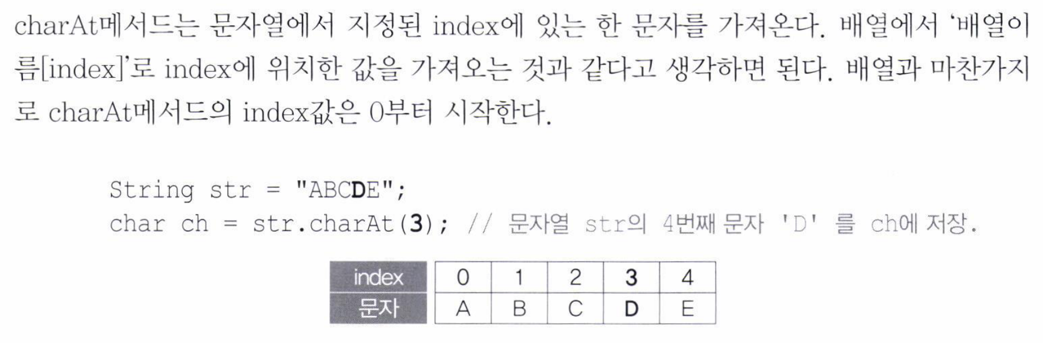

Slide 43
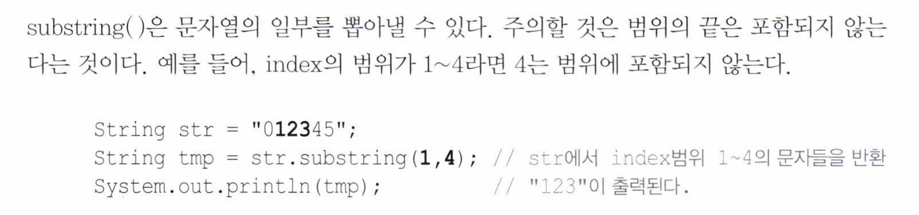

Slide 44
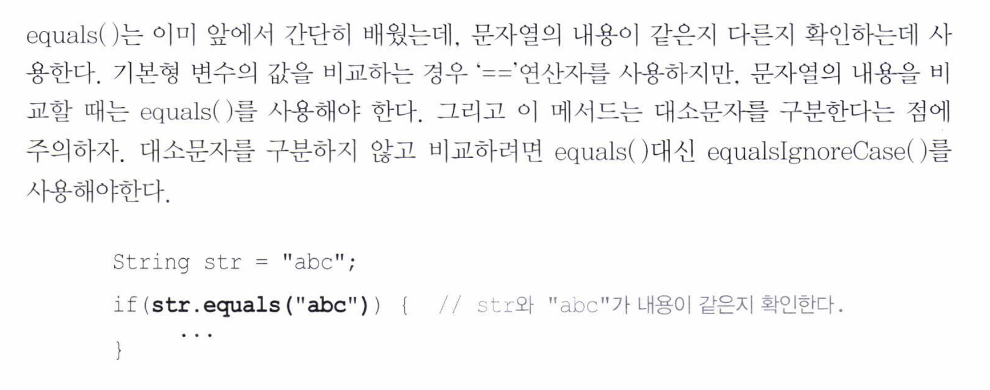

Slide 45
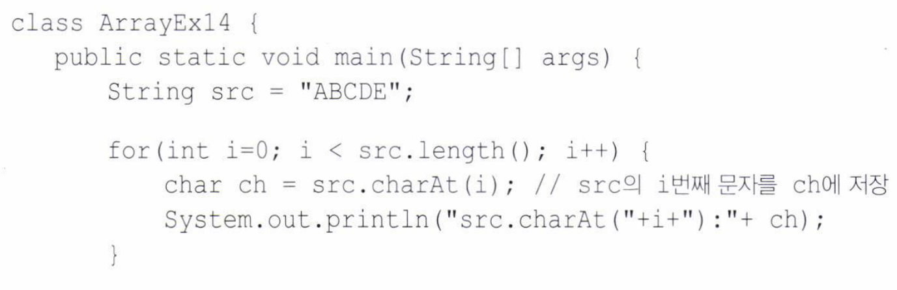
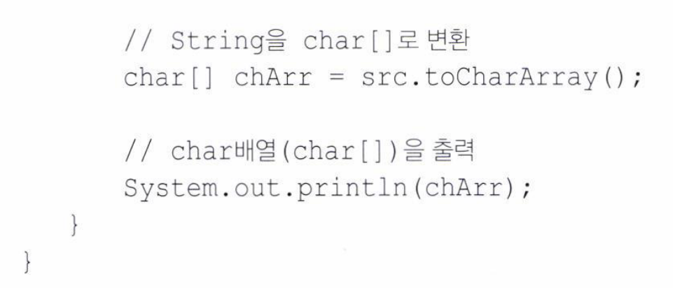
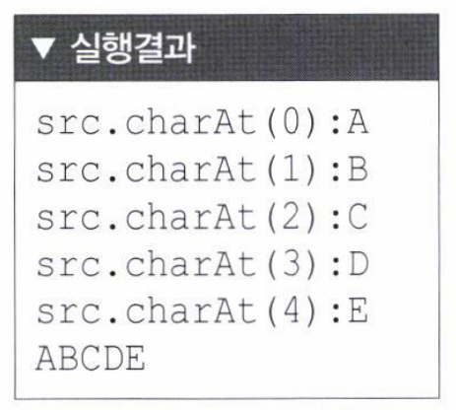

Slide 46
8 Array 8.2 Multi Dimensional Array

Slide 47
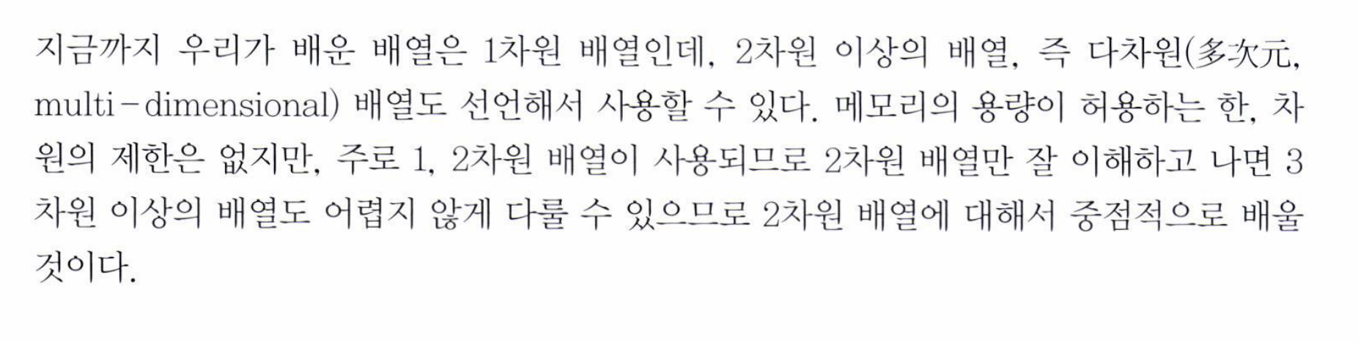

Slide 48
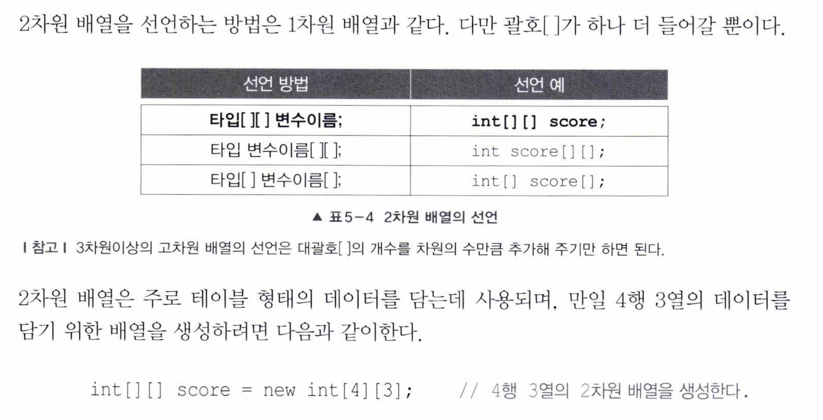
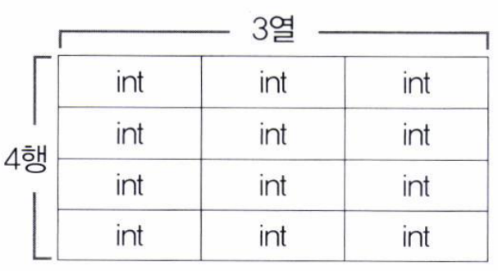

Slide 49



Slide 50


Slide 51




Slide 52


Slide 53



Slide 54


Slide 55
HTML
not yet…

Slide 56



Slide 57


